Slide 1

Resume Review
Code Club - 10/2/23

Slide 2

Things CPD has to offer CS students
What you can do with a major
Informational interview/job shadow
Resume & Cover letter review
LinkedIn setup, professional photo
Interviewing skills
Internship applications
Taking internships for credit
Graduate school applications
Corporate relations
Hosting job fairs/hiring events
Job hiring websites

Slide 3

Job application sites
Handshake - would highly recommend
Simplify jobs
Glassdoor
Wellfound - startups
USAJobs - government
Dice - tech jobs
Would not recommend:
LinkedIn jobs

Slide 4
Using resume keywords
Bots scan your resume for keywords
You may have the knowledge, but your resume might not say that
Use these websites for some keywords that may be useful:
https://novoresume.com/career-blog/resume-keywords-how-to-use-them
https://resumegenius.com/blog/resume-help/resume-keywords
https://www.jobscan.co/blog/powerful-verbs-that-will-make-your-resume-stand-out/#resume-keywords
Also - interest in jobs:
https://vault.com/library/collections/a-day-in-the-life

Slide 5
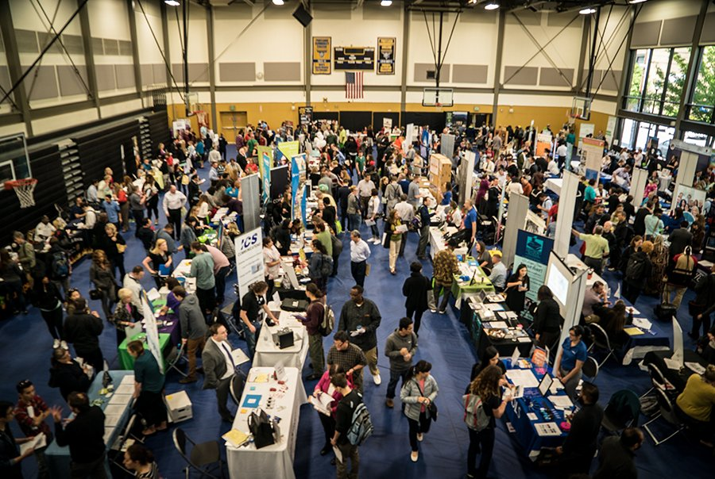
Professionalism Tips
Wear a suit/professional attire
Must have a LinkedIn
GitHub is also useful
Especially if you have side projects
Business cards can help
Note the HPU cards don’t have a lot of good info on them
Resume website good, especially early on
Don’t worry about it being ready by tomorrow
Hackerrank, leetcode, etc.
Only link to these if you are proud of them

Slide 6
Anthony Resume Presentation

Slide 7
Website/LinkedIn/Resume/Company Research

